Slide 1

SOCIOGRAPHY
-MADE BY VADIK AMAR(20BCS2872)

Slide 2
About Sociography
Sociography is a social networking web service designed with the help of front end- html, css and javascript and back end- sql, php. The sql and php will connect to a database to keep the records of the systems. Html is used to give structure, css is used to style and to decorate, and javascript is for functioning of website.

Slide 3

TECHNOLOGY USED
HTML, CSS, JS, SQL

Slide 4

Software Requirements
VS Code, Xampp AND Chrome (any browser)

Slide 5
Project Design
1. Login , Signup, Contact Page
2. Home page
3. Profile of user

Slide 6

Home Layout

Slide 7
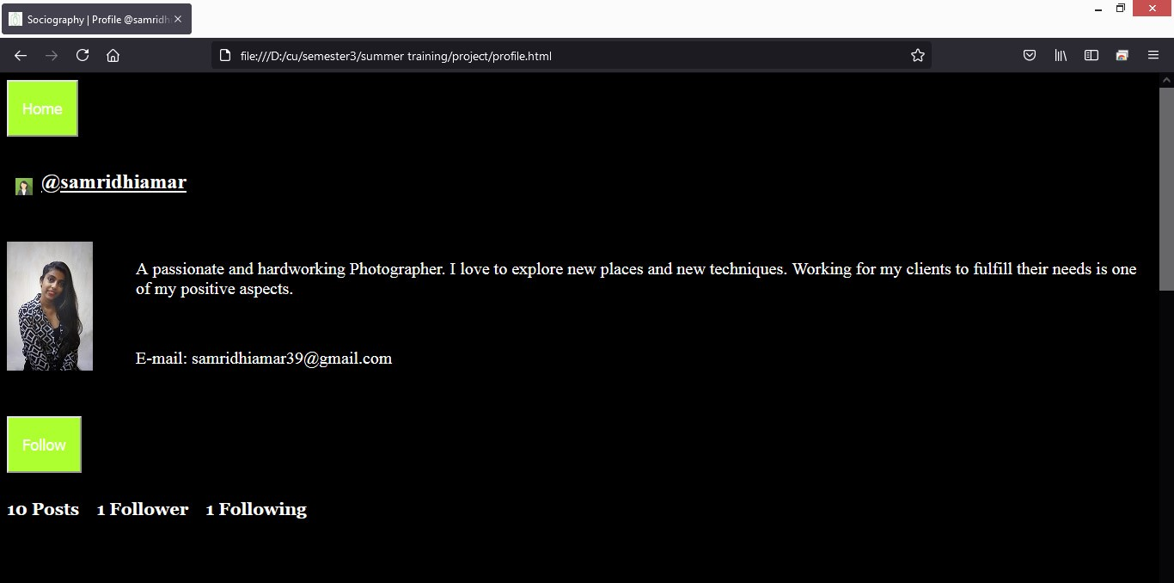
Profile Layout

Slide 8
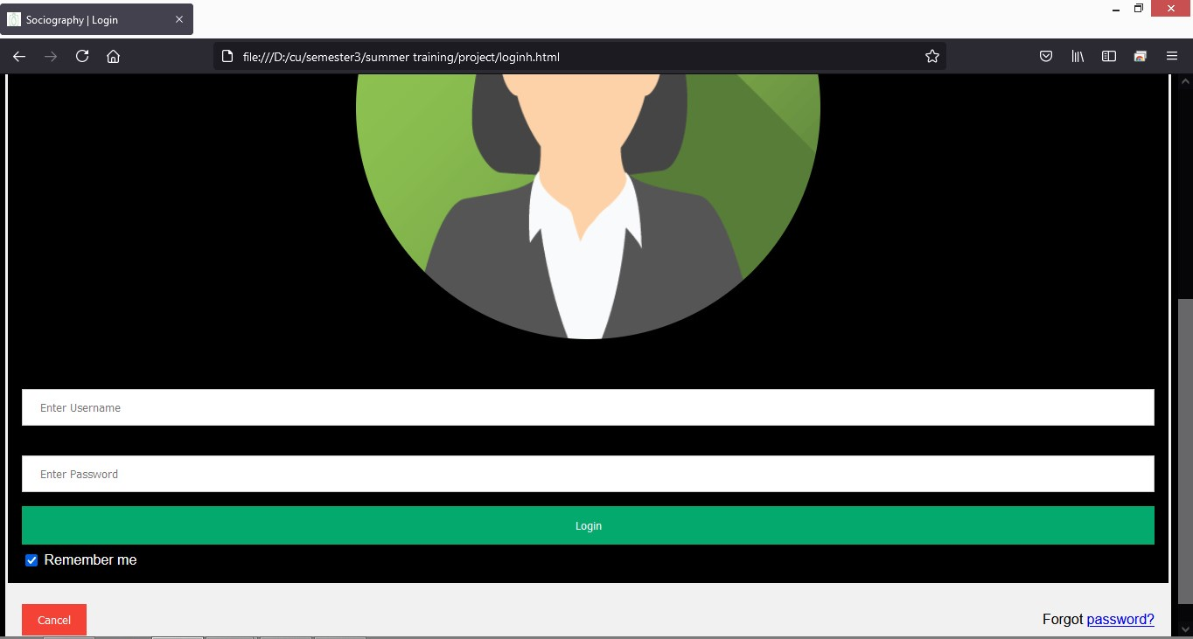
Login Layout

Slide 9
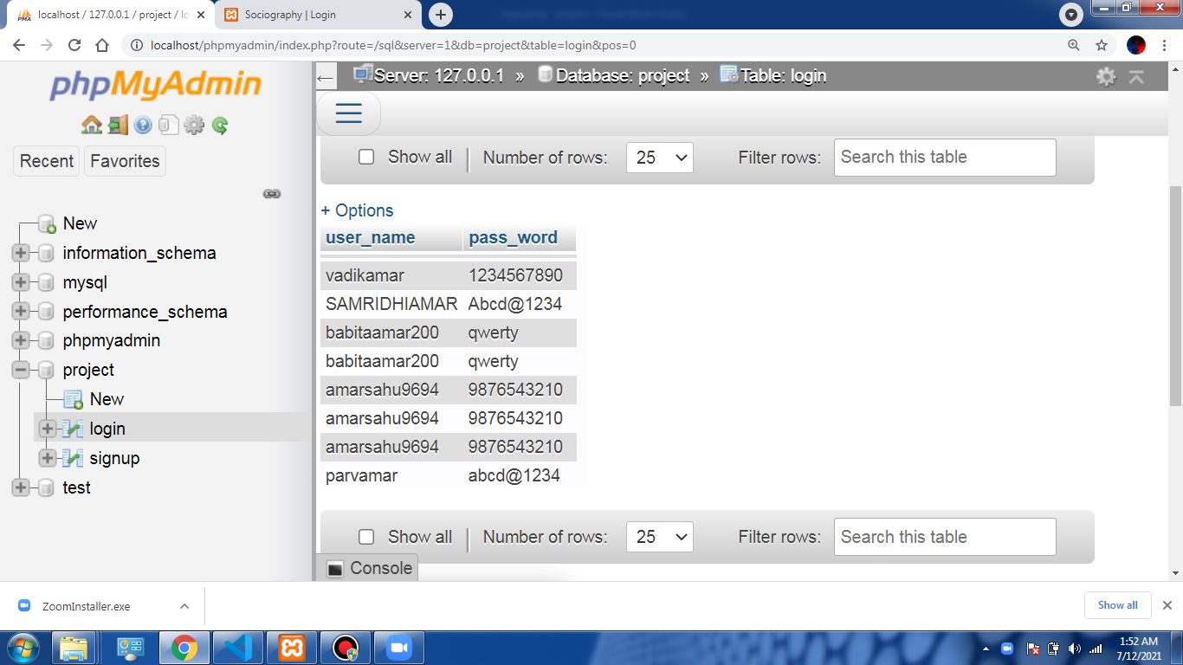
Login Database

Slide 10
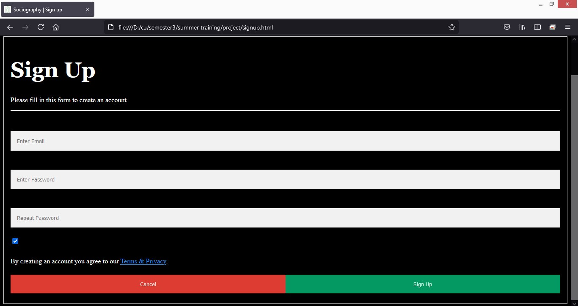
Signup Layout

Slide 11
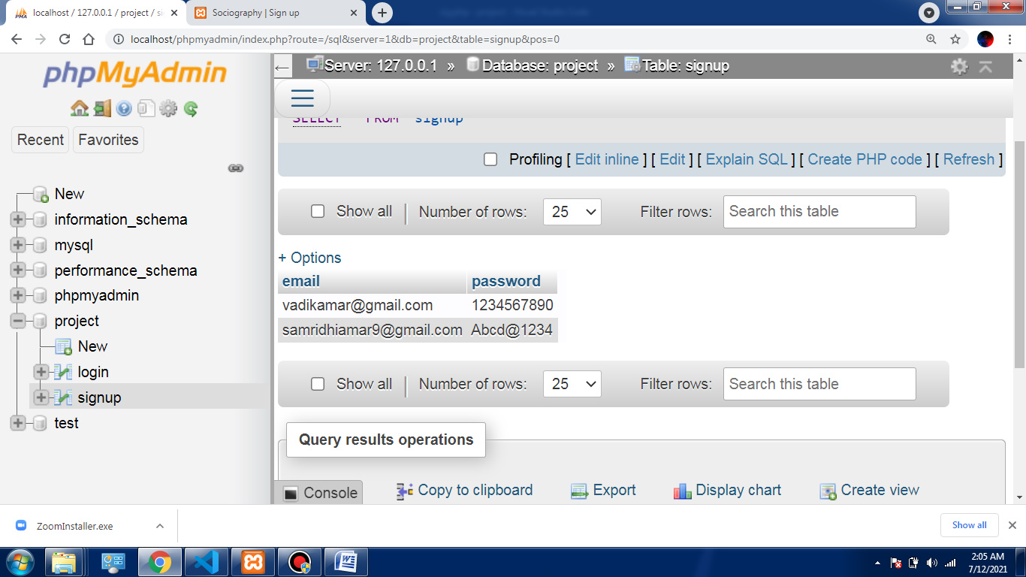
Signup Database

Slide 12
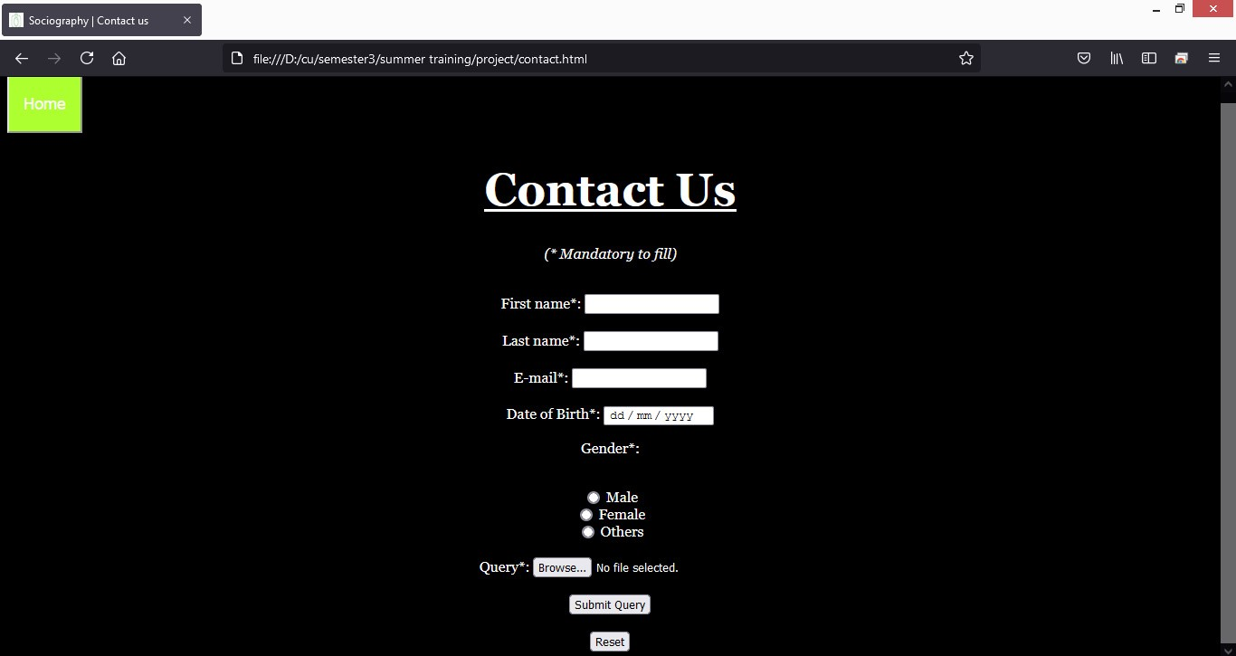
Contact Layout

Slide 13
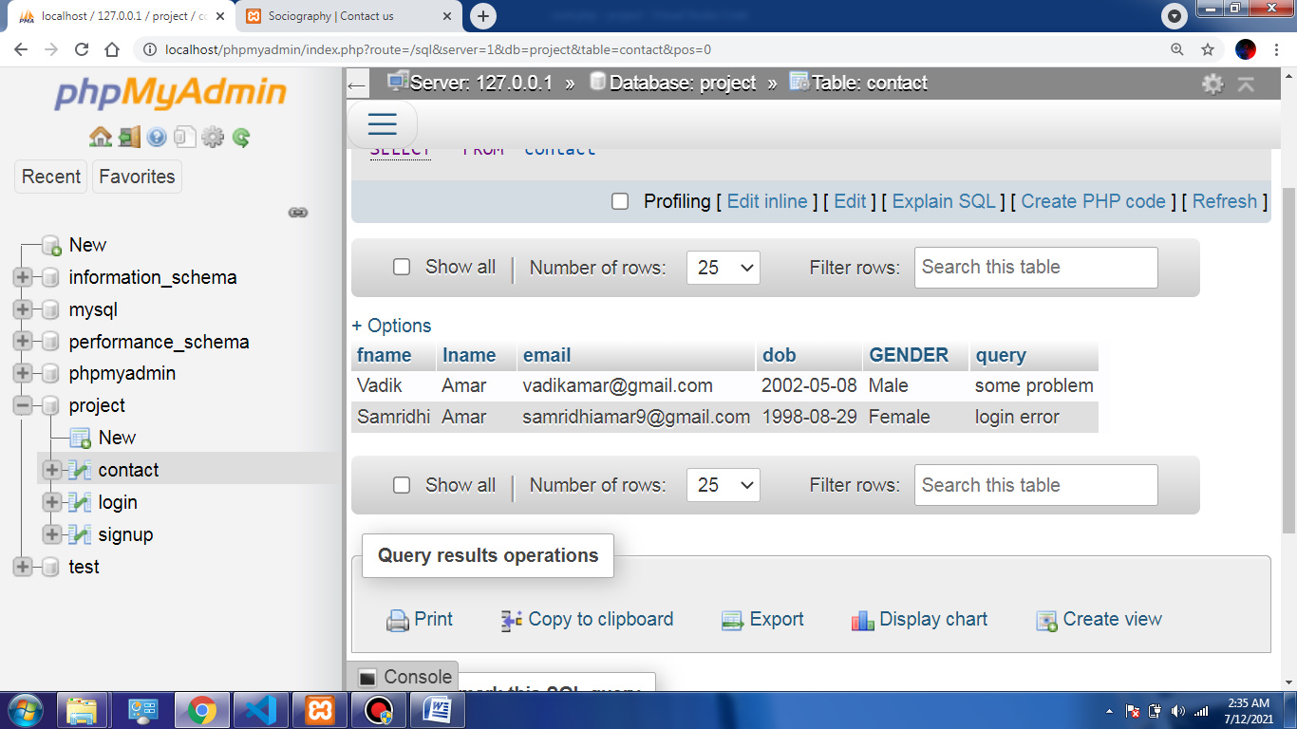
Contact Database

Slide 14
APPLICATIONS
People can hire photographers for their purposes.
Top user/photographer can appear on the home page.
Photographers can express themselves and also can keep an eye on their competitors.
Simple design, easy to use interface.

Slide 15


